Slide 1

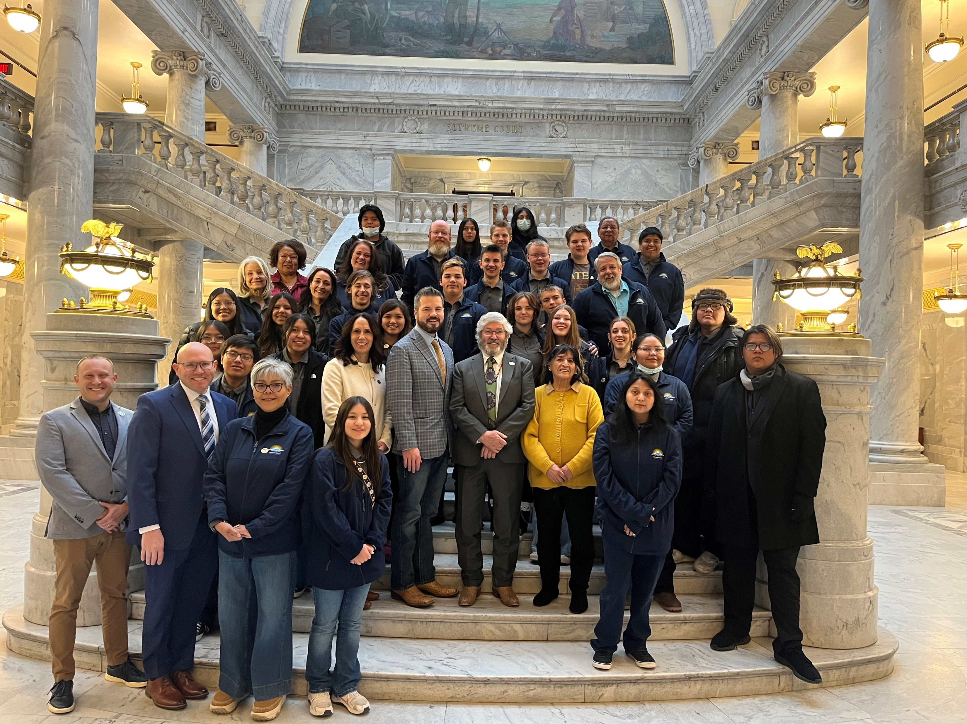
CAPITOL HILL DAY 2025

Slide 2
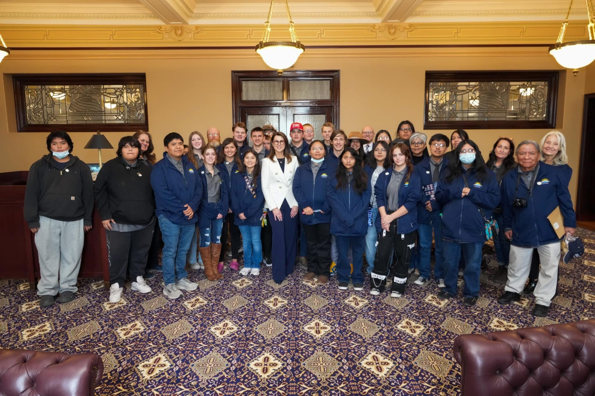
Capital Hill Day with Lt. Governor with kids from San Juan County

Slide 3
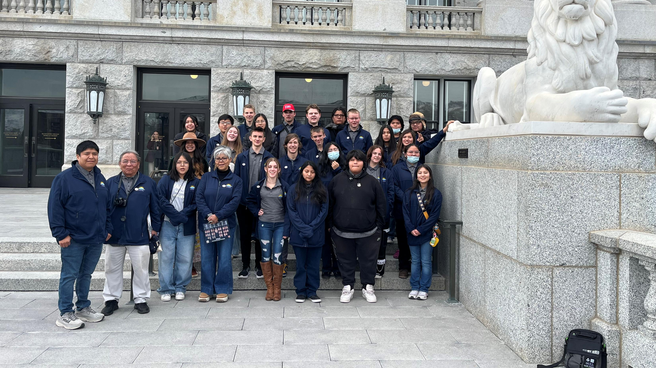
Outside of the Capital

Slide 4
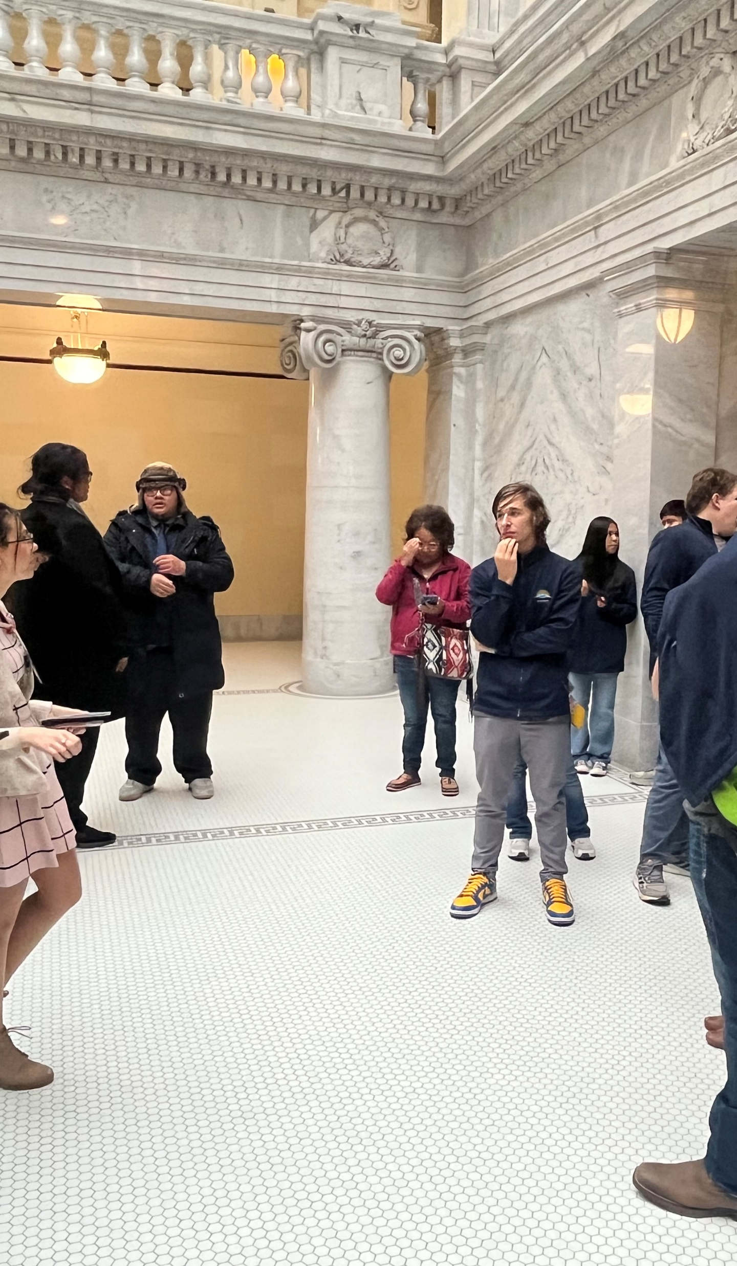
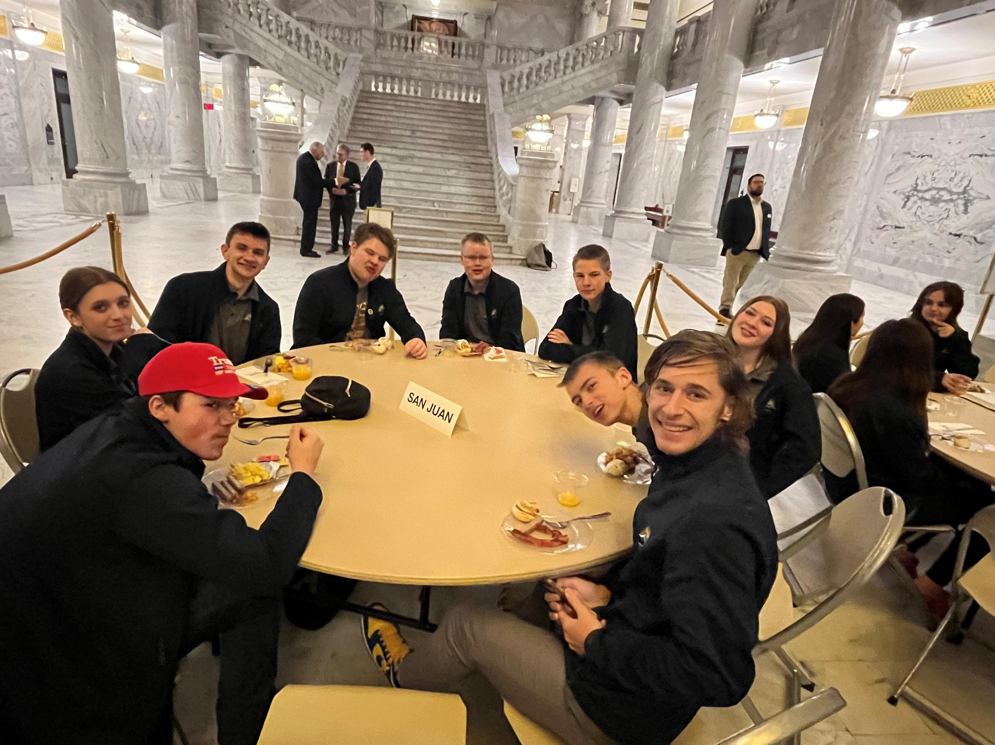
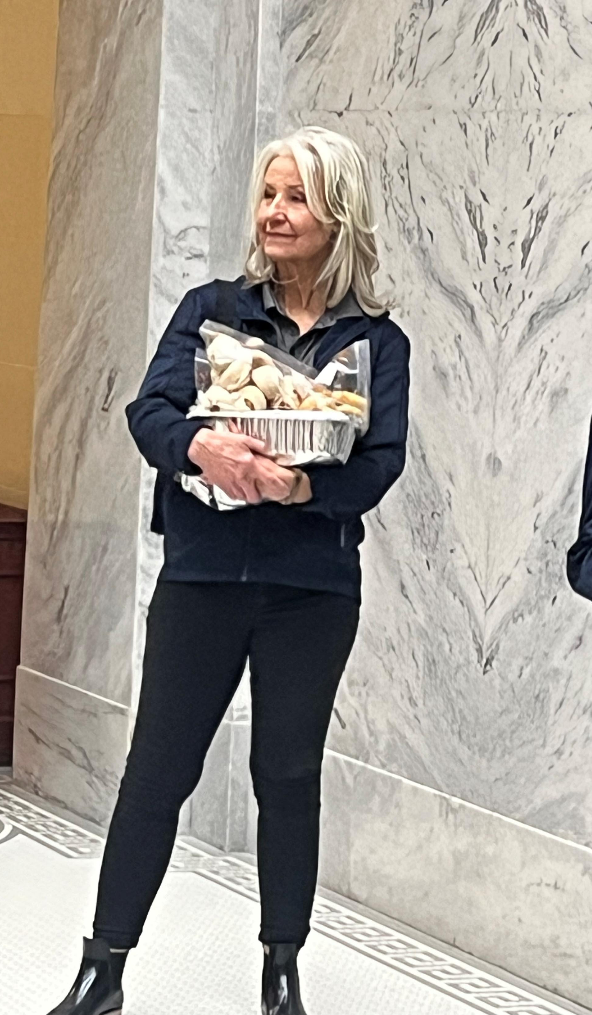
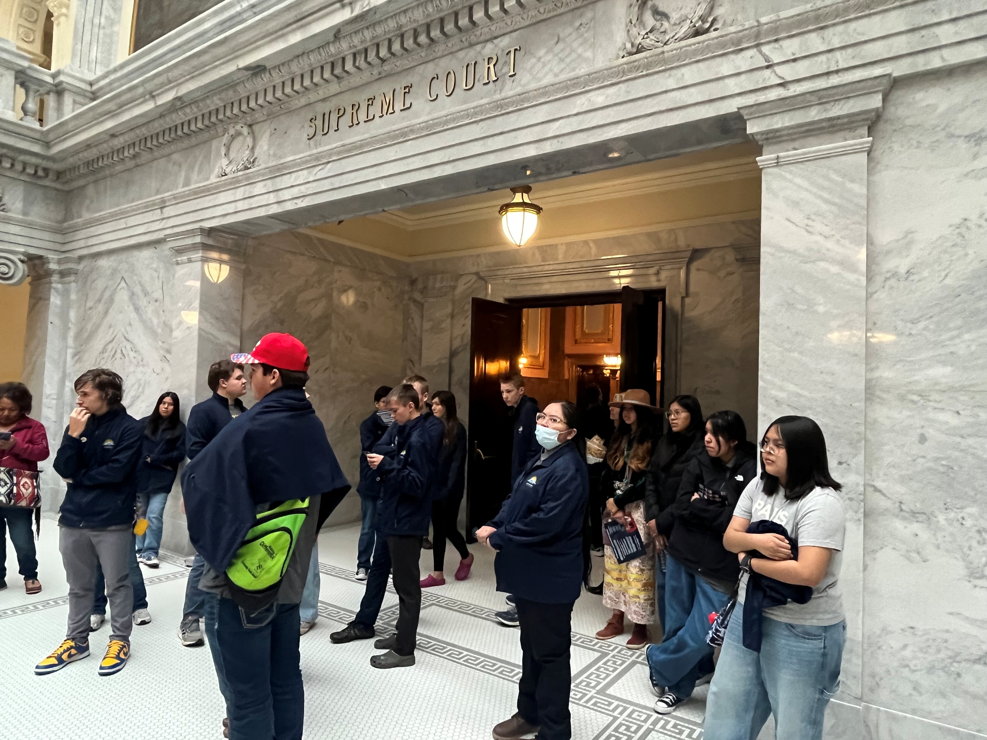

Slide 5
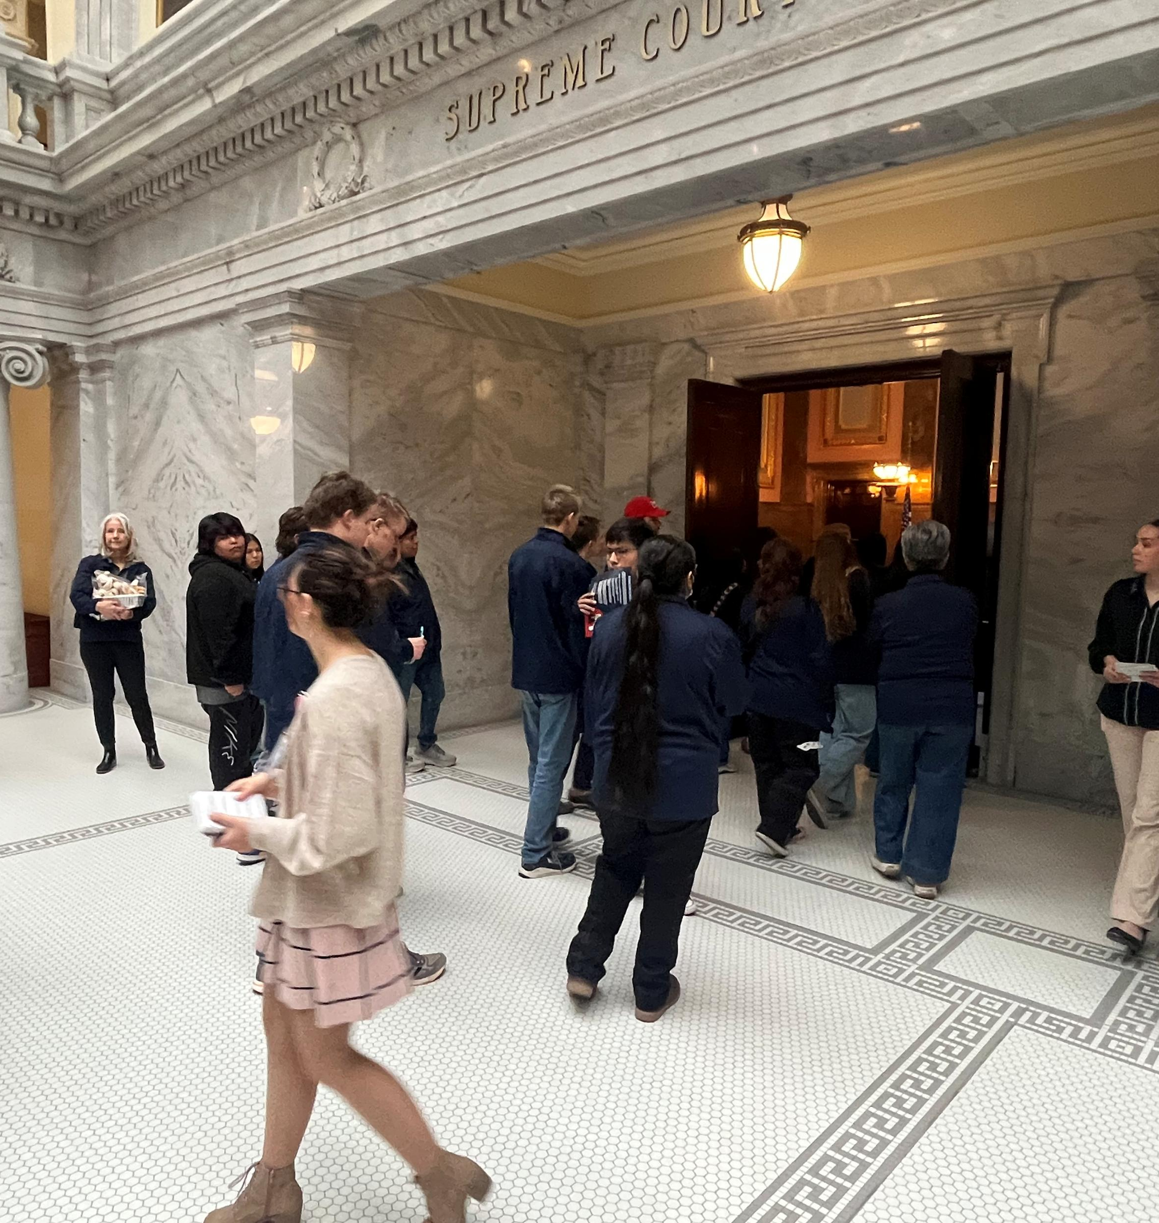
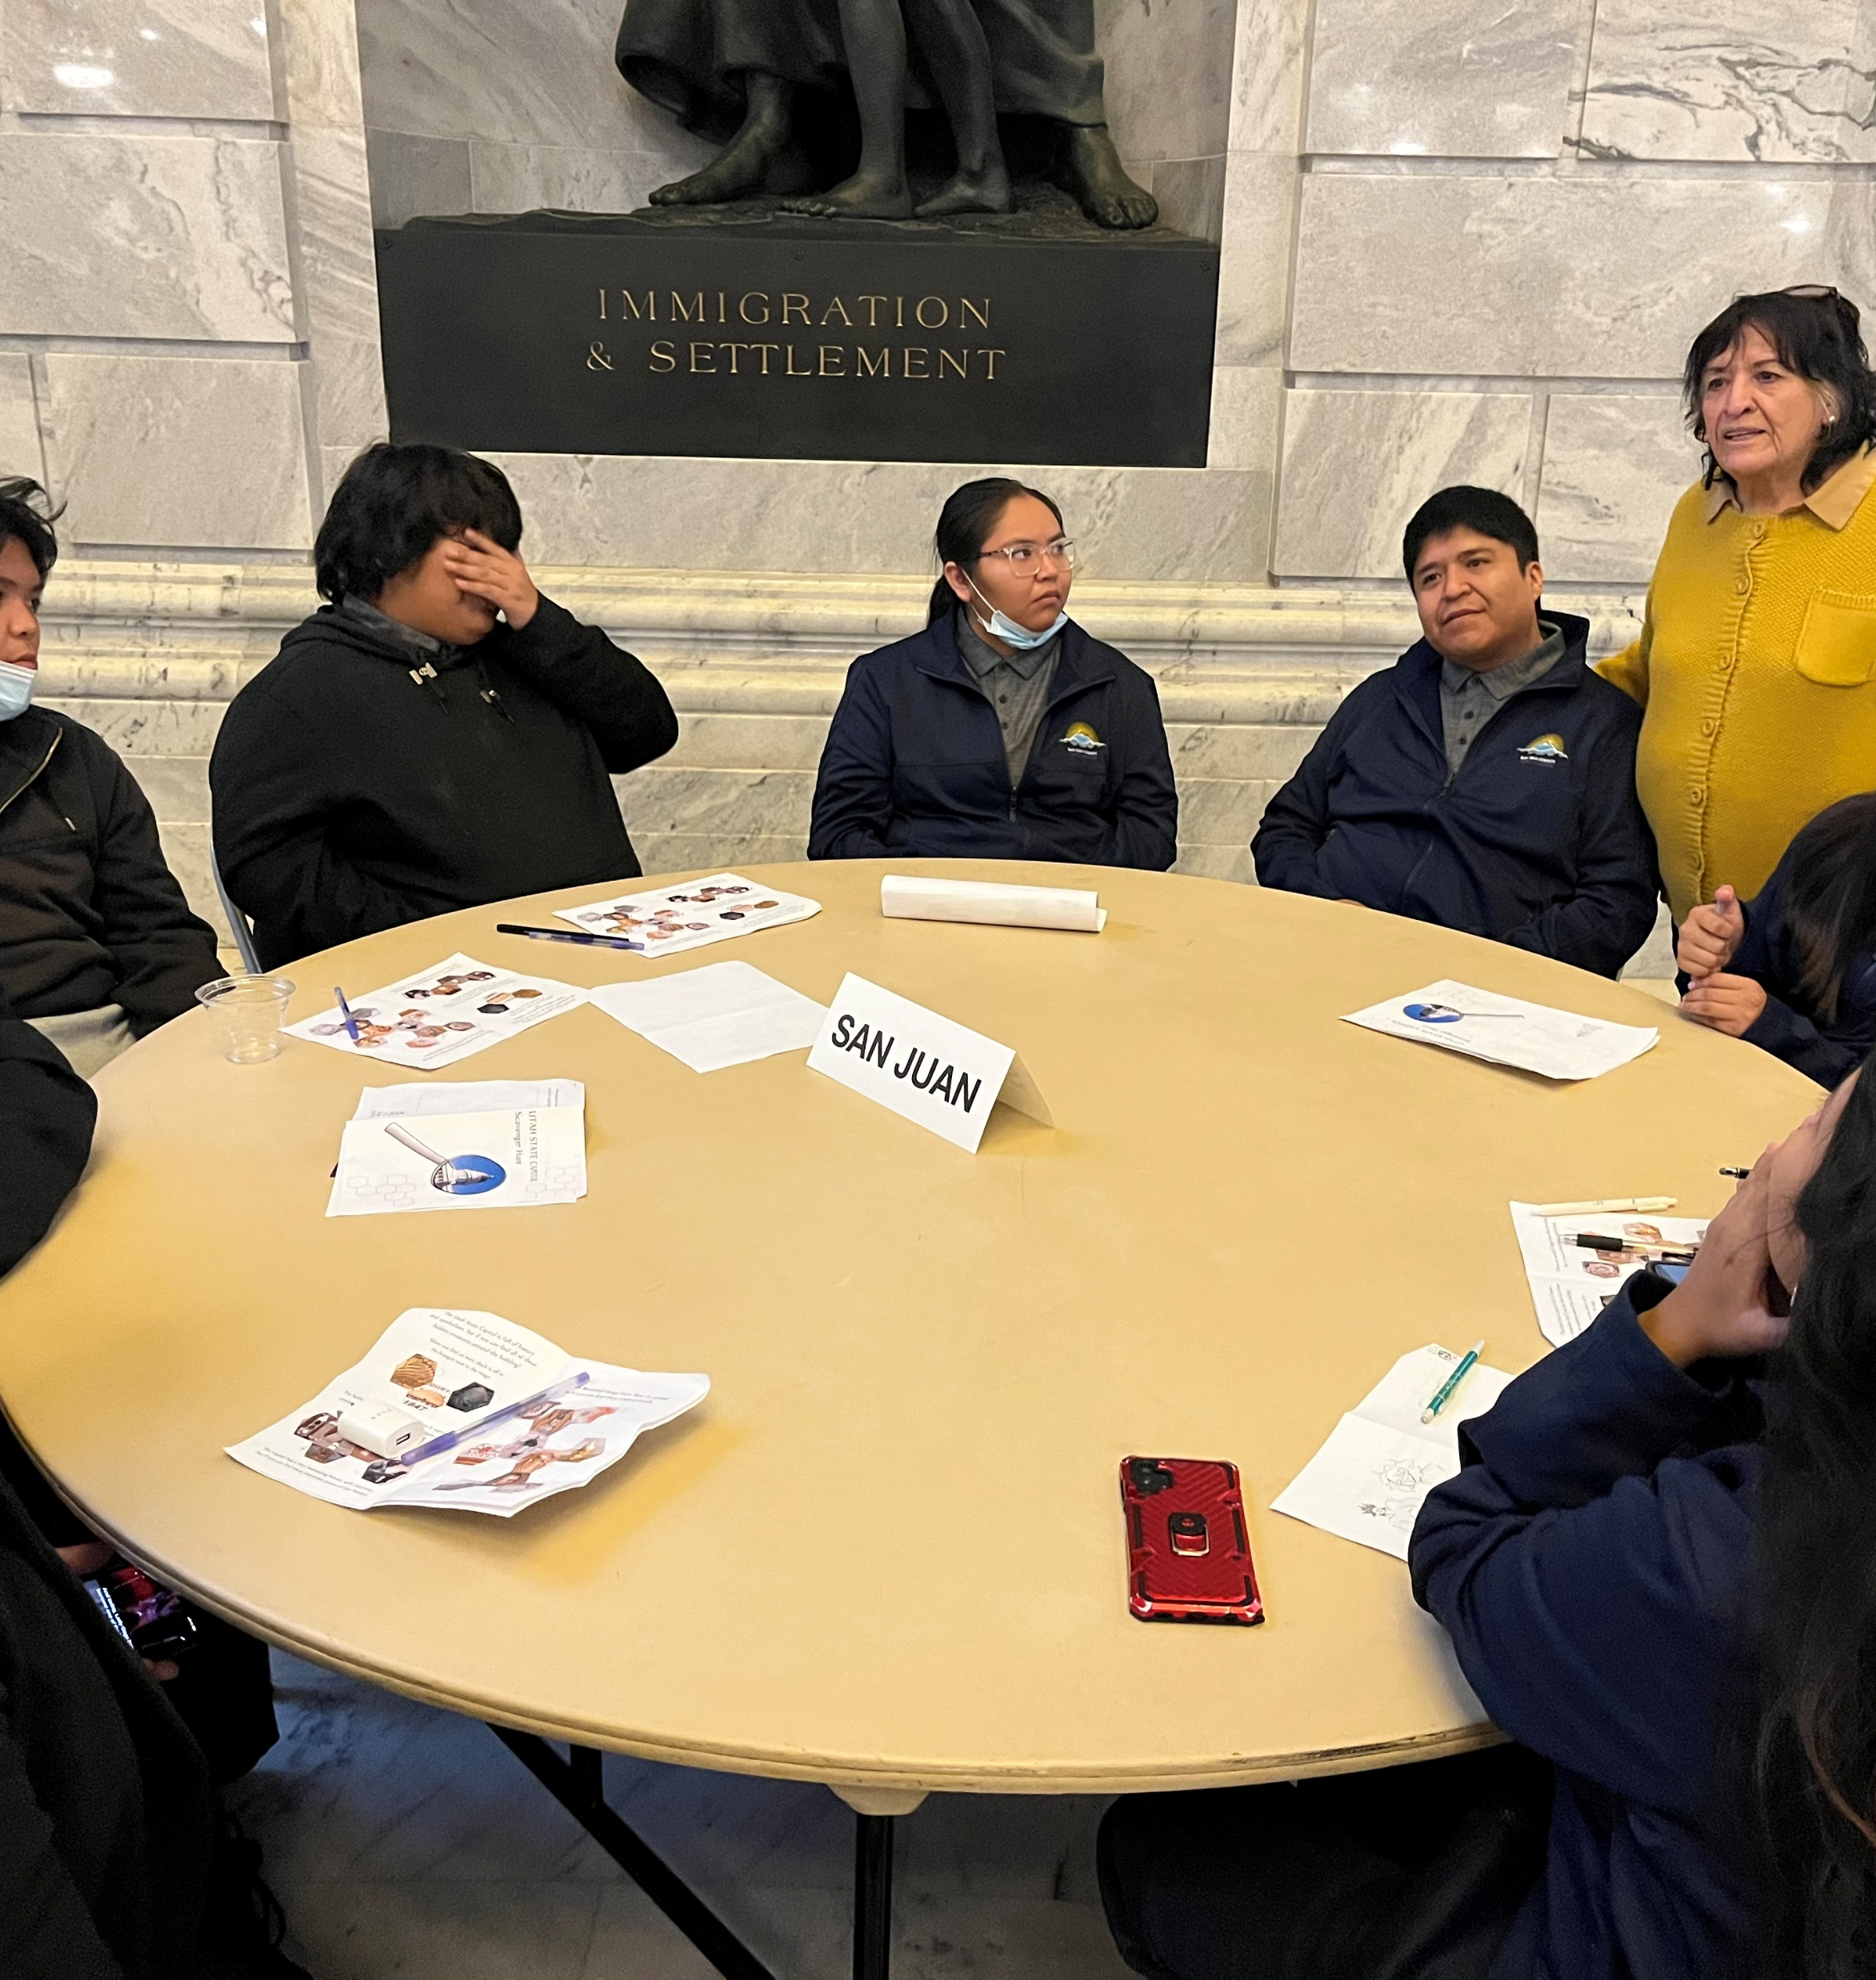
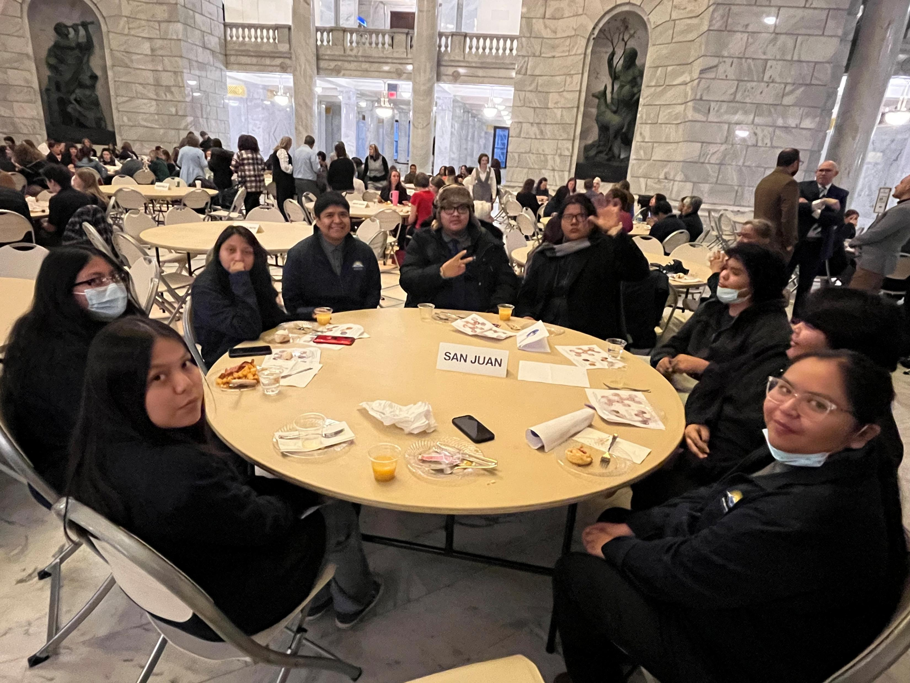
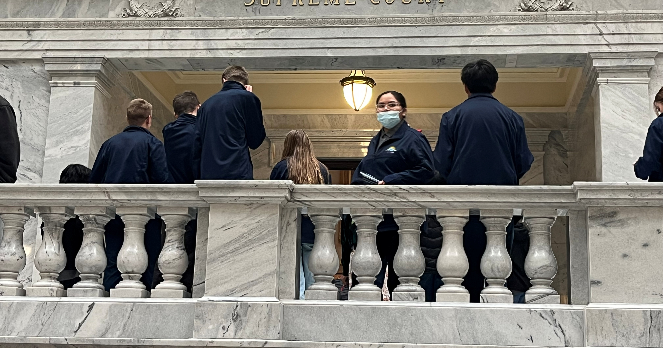
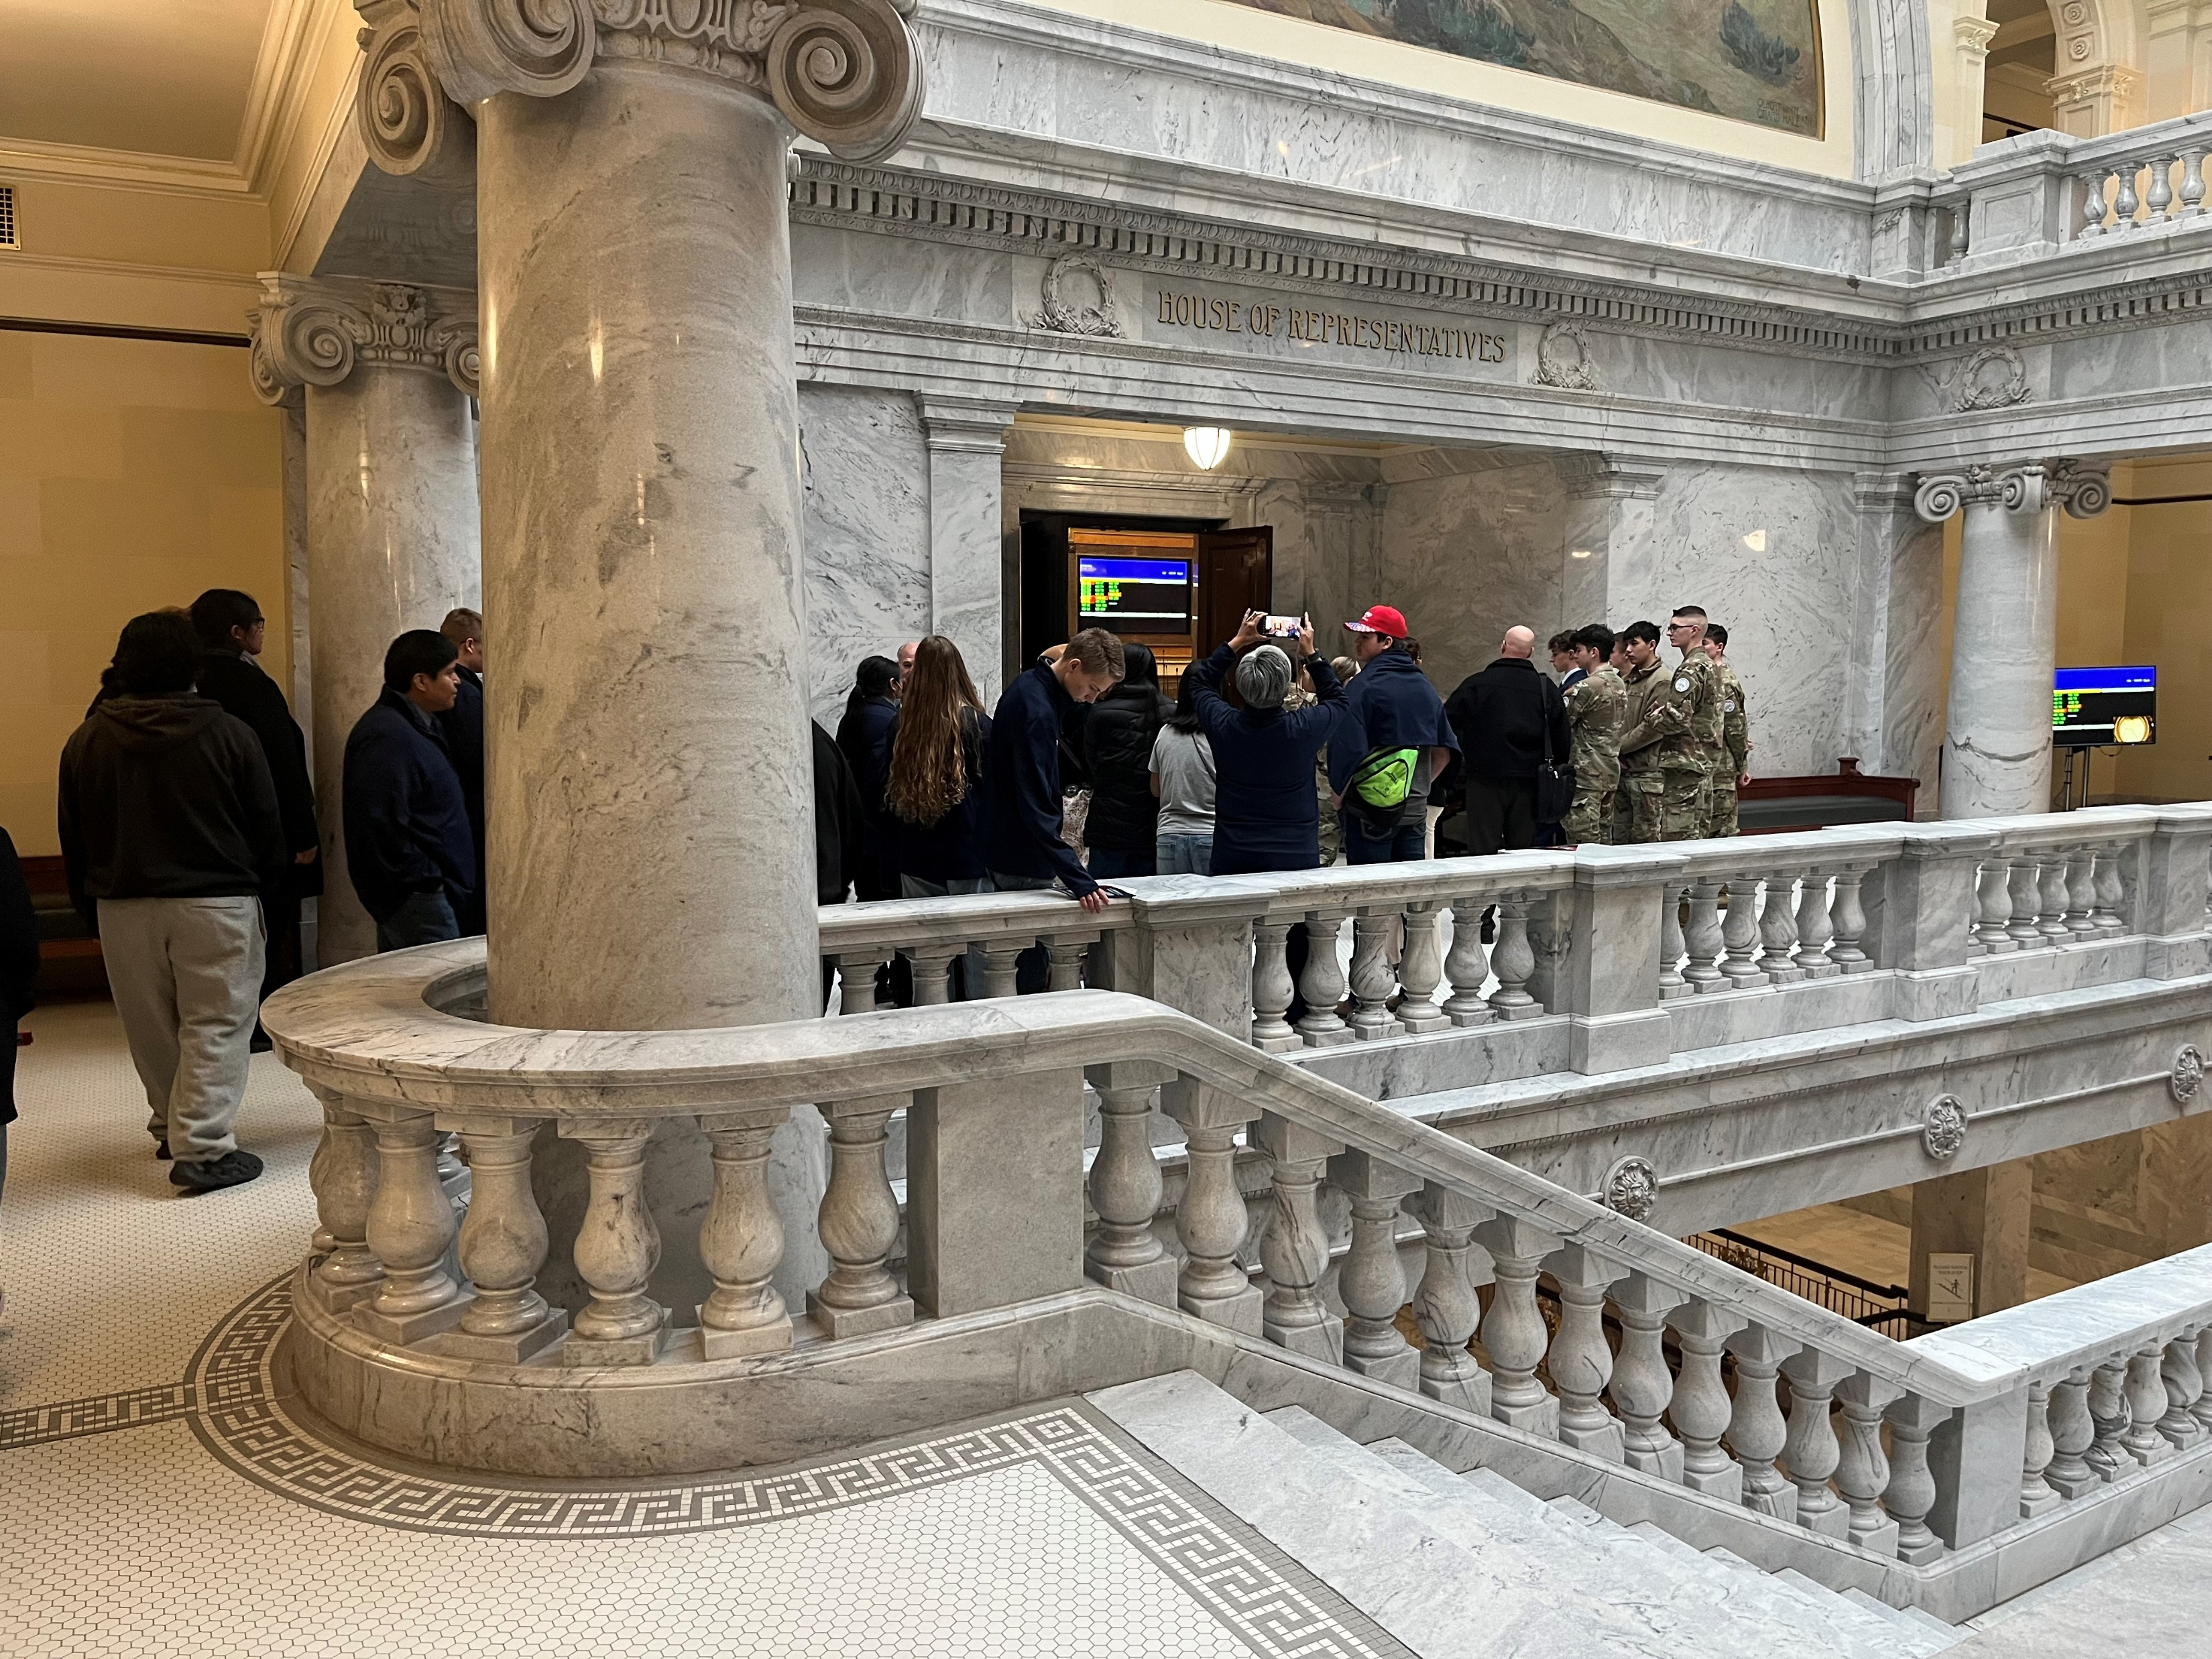
San Juan Youth Meeting with Silvia Stubbs

Slide 6
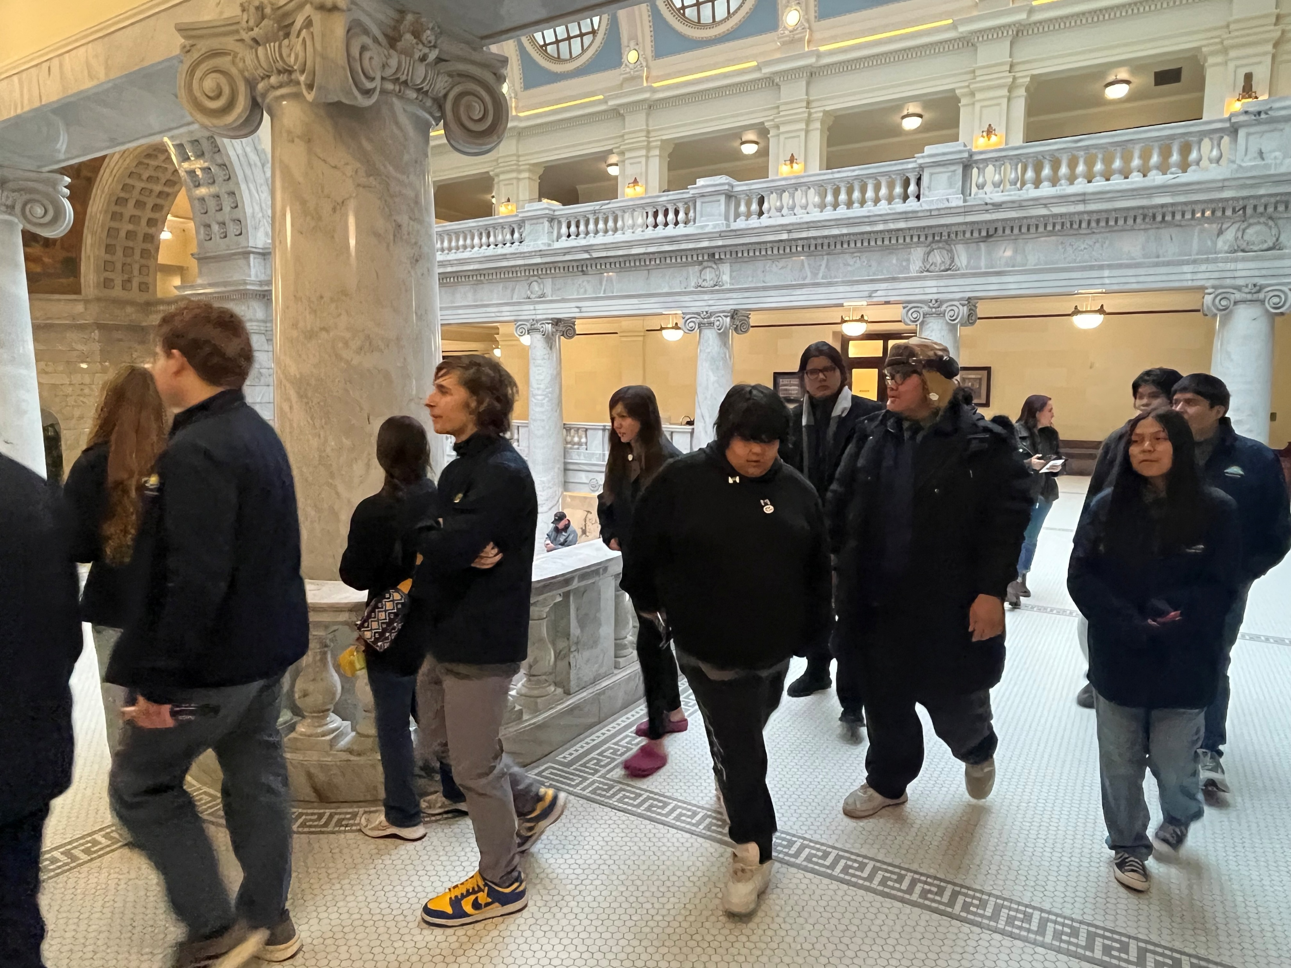
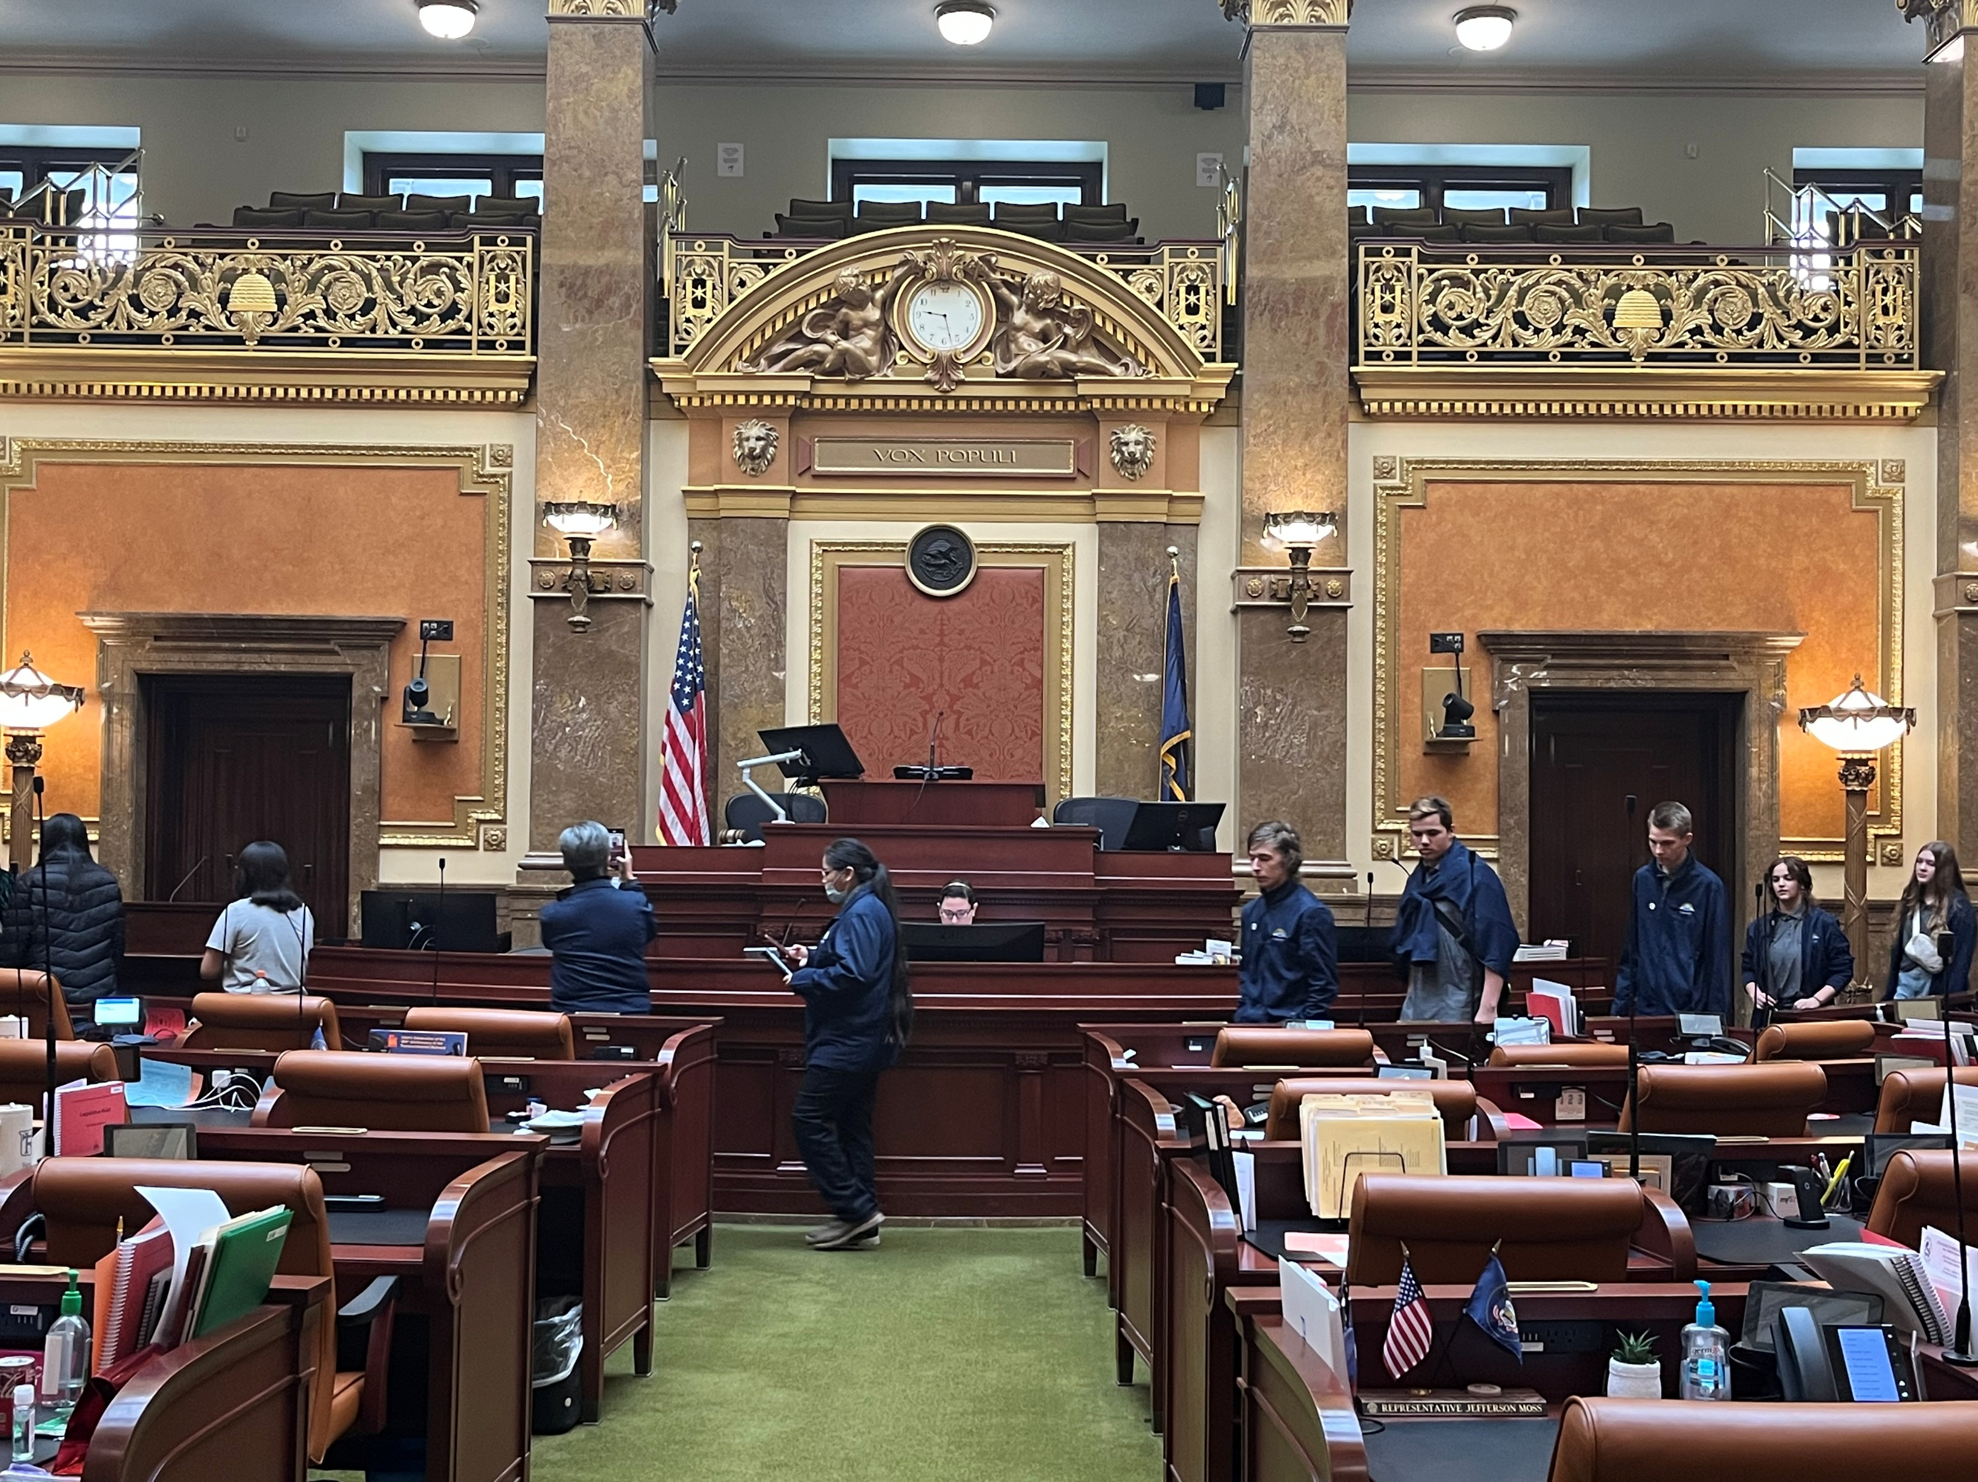
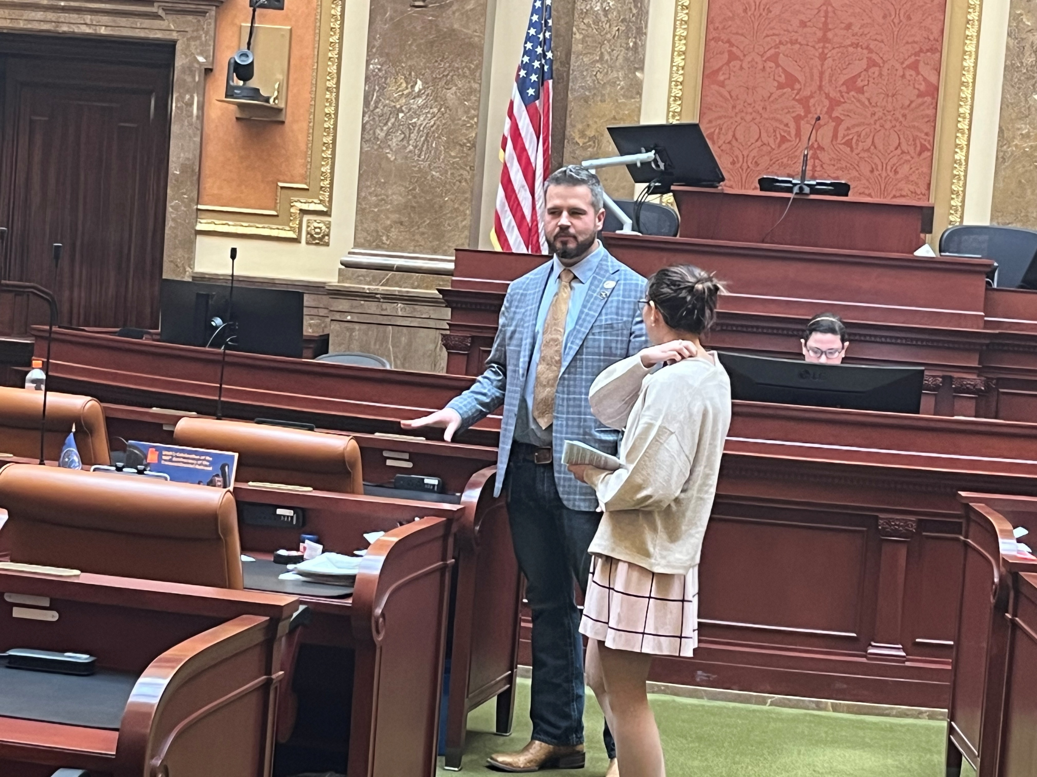
Meeting with House of Representative Logan Monson

Slide 7
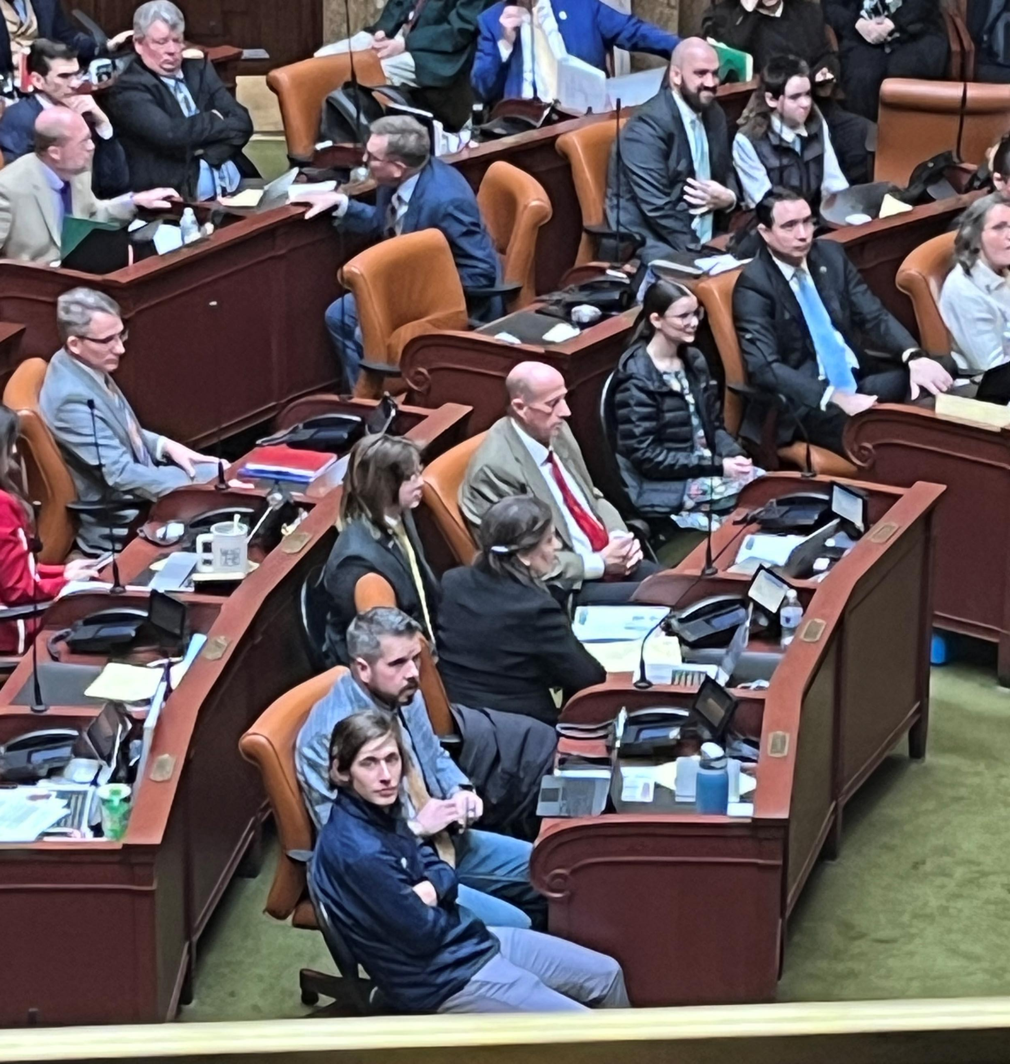
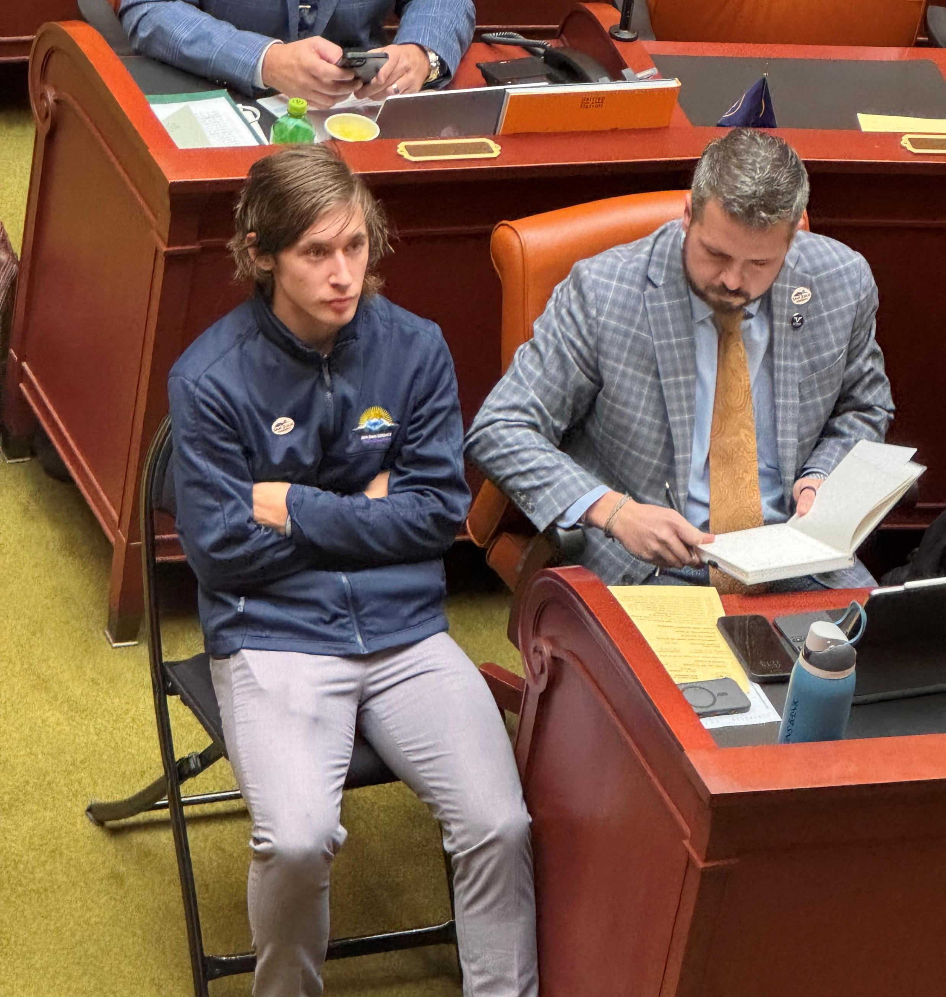
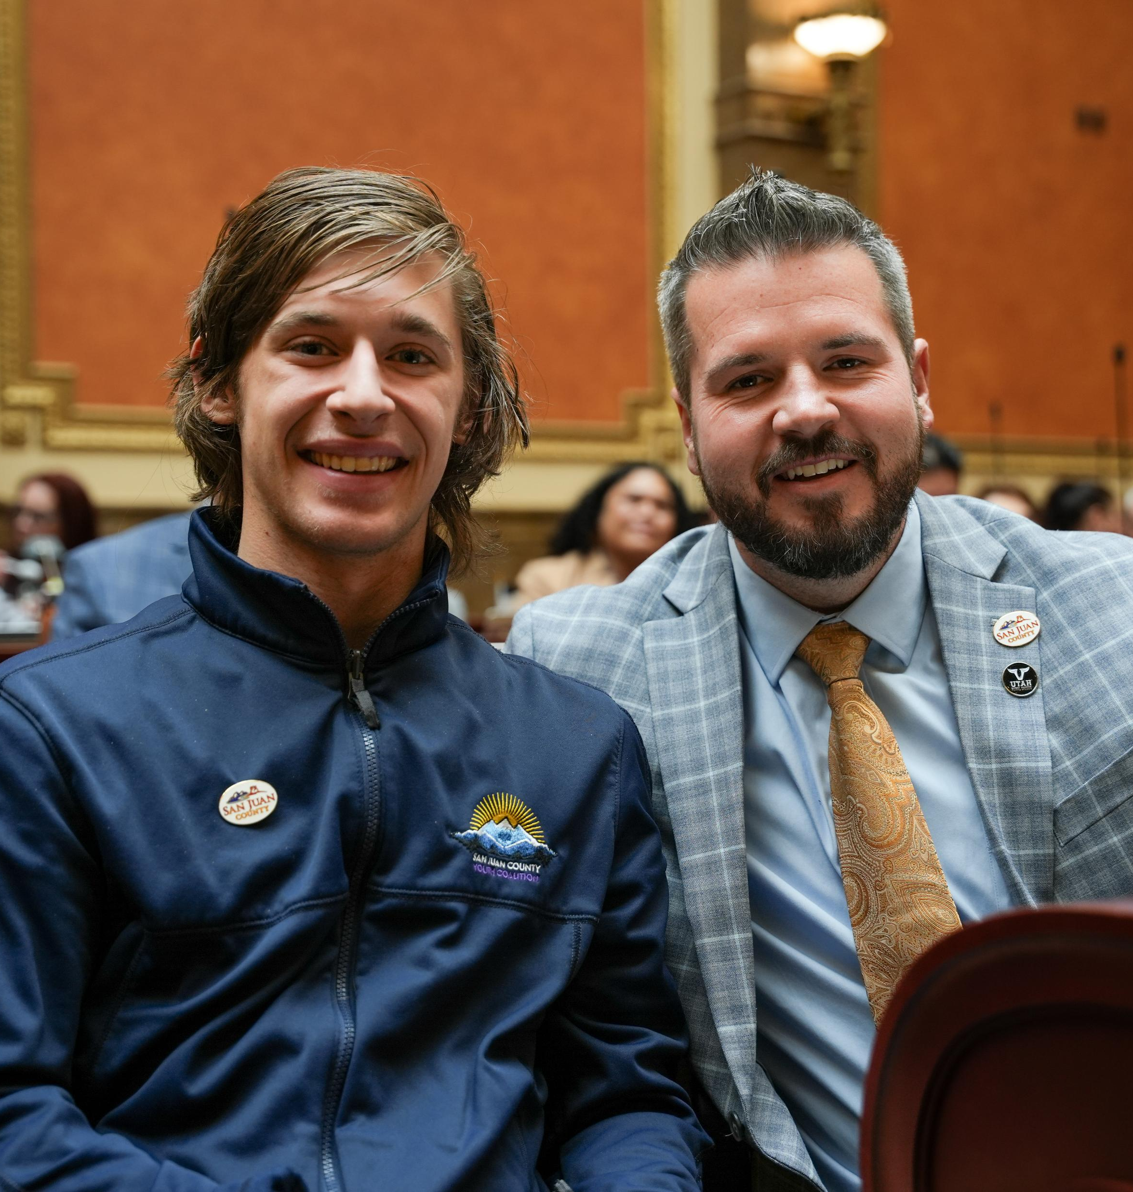
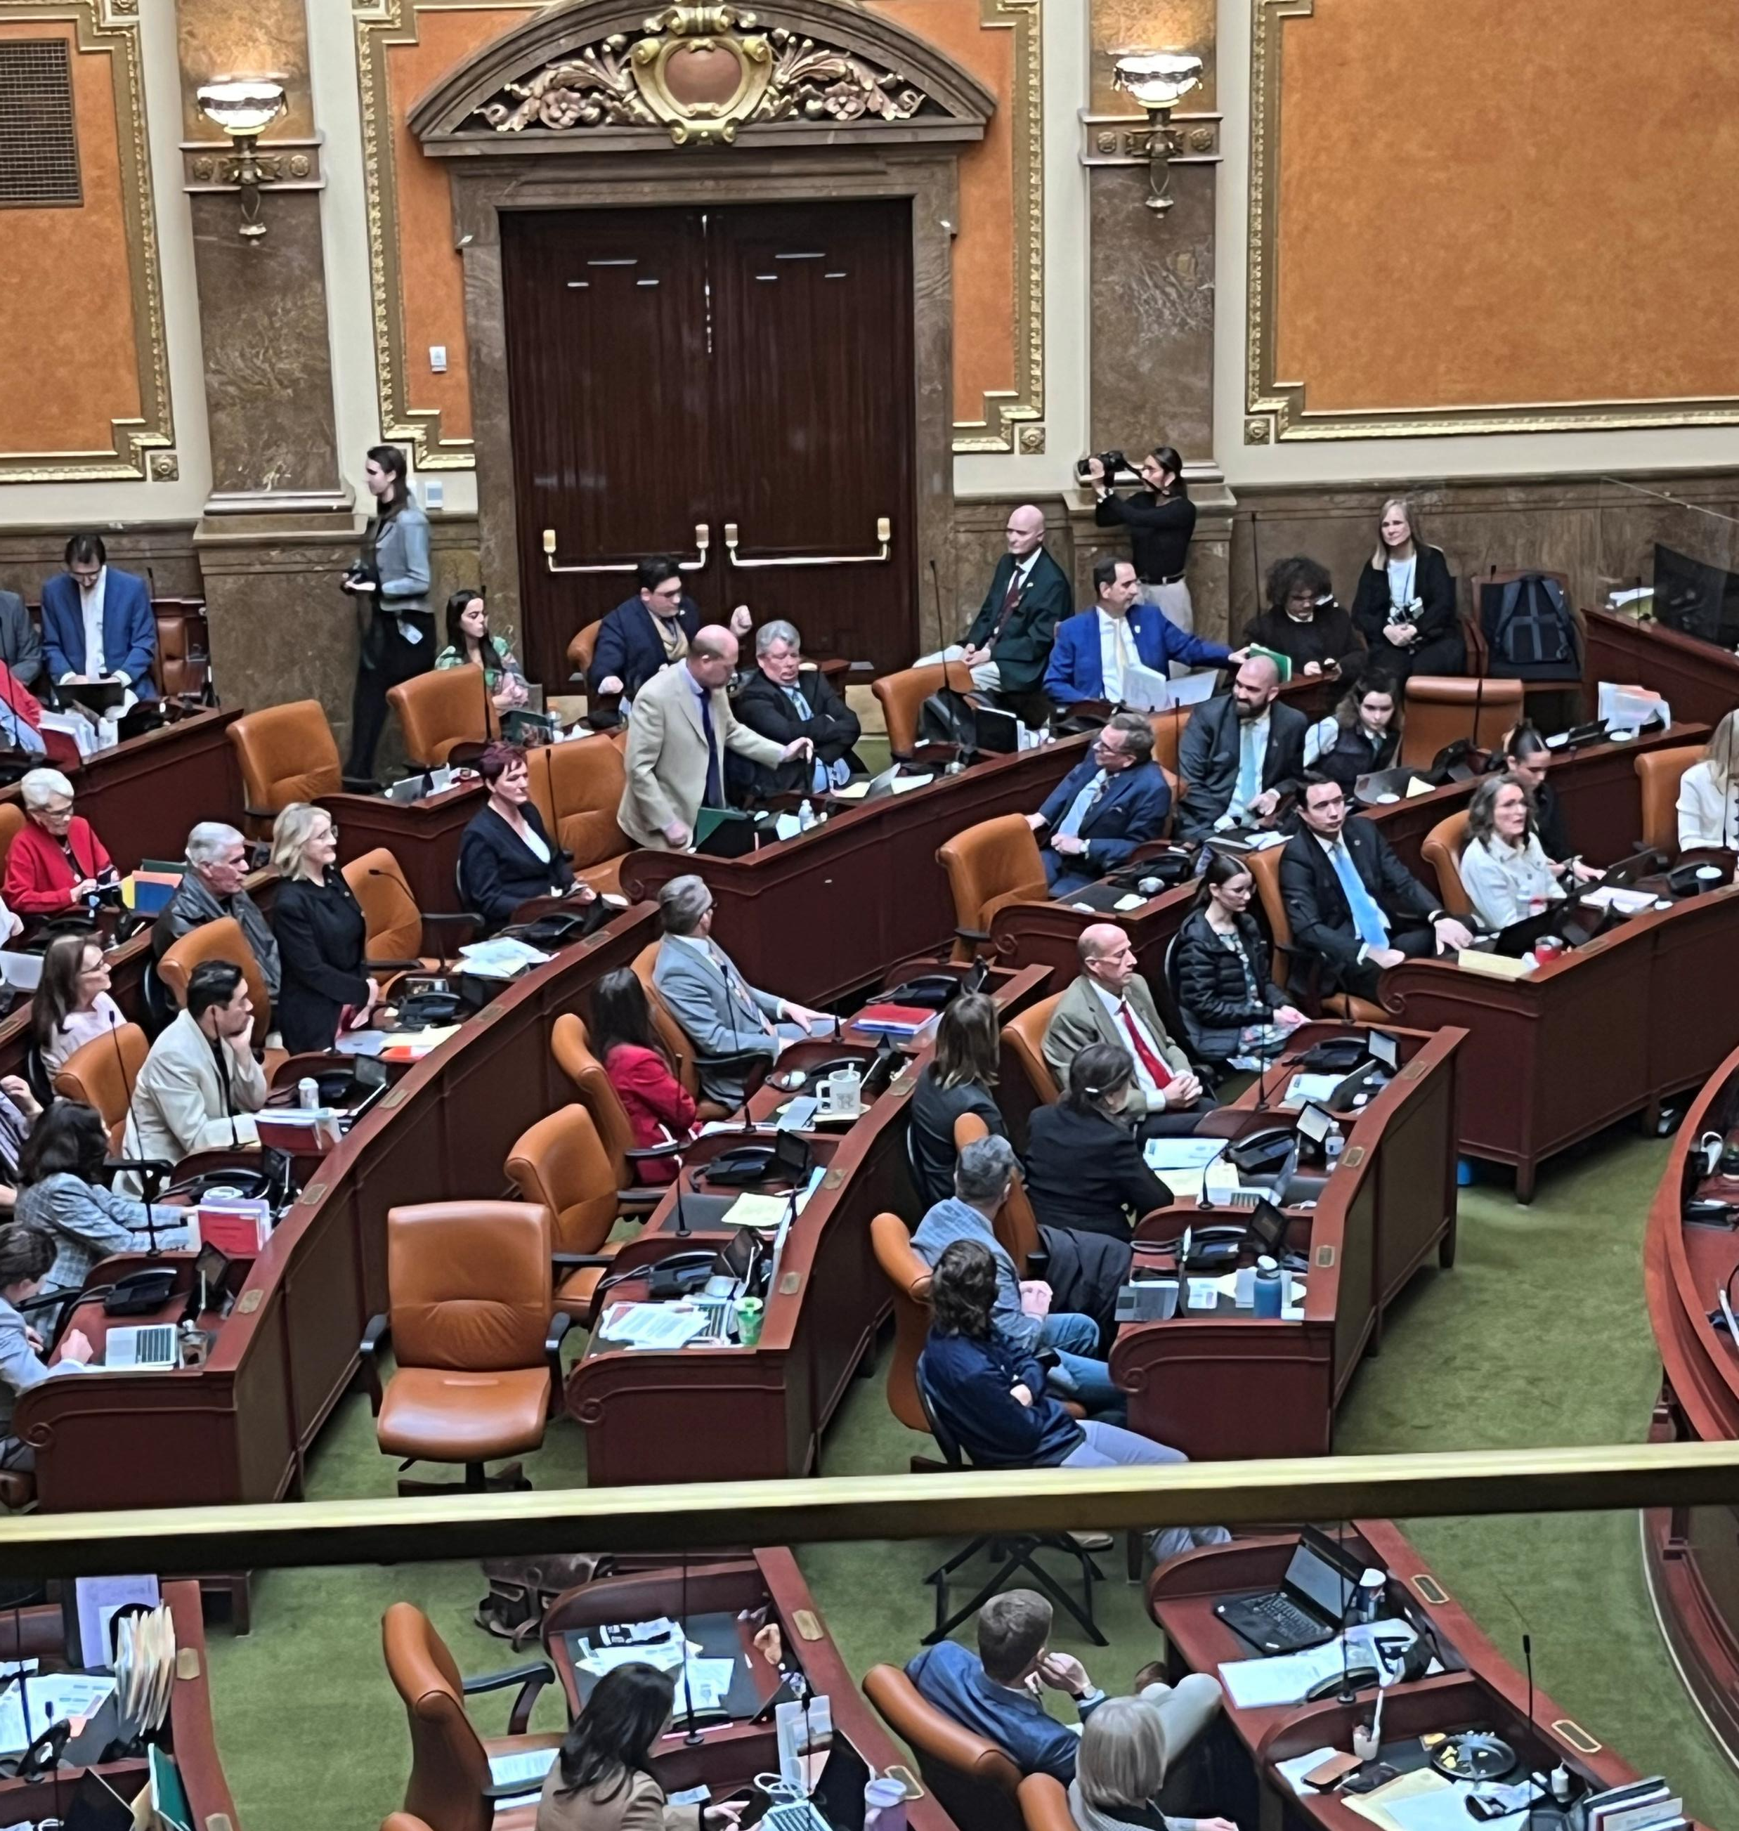
San Juan Youth Coalition member Noah sitting with House Representative Logan Monson during the House Meeting.

Slide 8
The San Juan Youth Coalition is at Capitol Hill to meet with House Representatives, advocating for youth-focused initiatives that promote mental health, addiction prevention, education, and community engagement in San Juan County. Our mission is to empower young people through support, education, and safe spaces, fostering leadership and resilience. Our Goals: Advocate for Funding: Secure financial support for mental health and substance abuse prevention programs. Share Success Stories: Demonstrate the positive impact of our programs on local youth. Build Legislative Support: Gain backing for youth development and mental health initiatives. Foster Collaboration: Establish lasting partnerships with policymakers. We aim to highlight the importance of mental health resources, early intervention for substance abuse, and the transformative impact of our programs. By building connections and advocating for essential resources, we strive to create a brighter and healthier future for San Juan’s youth. Thank You for Your Support! We look forward to collaborating with legislators and amplifying the voices of our young leaders.

